Slide 1
Hidden Markov Neural Networks
Review of article by:
L. Rimella and N. Whiteley (2025)
Presentation by AMAS 2025 Group 1

Slide 2
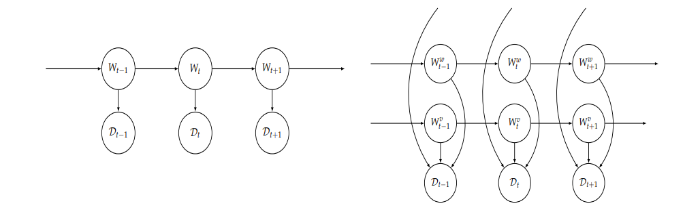
Hidden Markov Models
Markov chain
Hidden states
Observations
Transition probabilities
Emission probabilities
https://www.mdpi.com/1099-4300/27/2/168

Slide 3
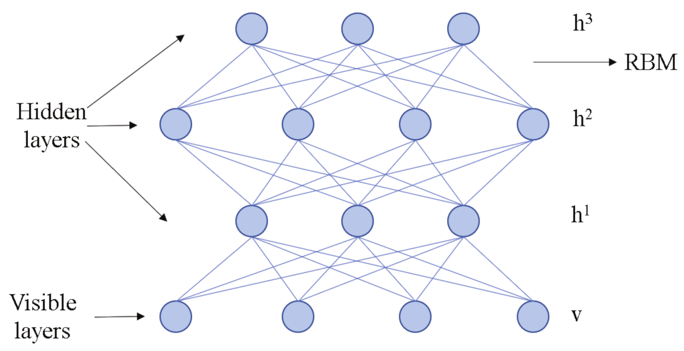
HMNN
Treating the hidden weights as hidden states in a HMM
Static vs dynamic weights during inference
NN needs expensive retraining
Continual learning - forgetting and adapting
https://www.mdpi.com/2076-3417/11/7/3138

Slide 4
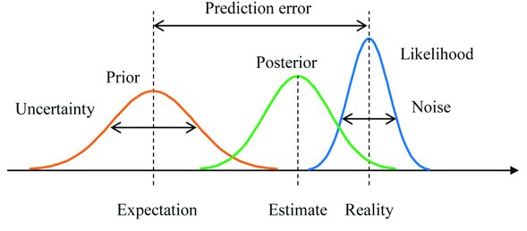
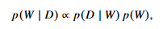
Bayesian Machine Learning
Bayes Theorem
Prior - Transition model
Likelihood - Emission model
Posterior distribution of weights
https://sarowarahmed.medium.com/understanding-the-prior-and-the-posterior-distributions-0f36f8737ecc

Slide 5
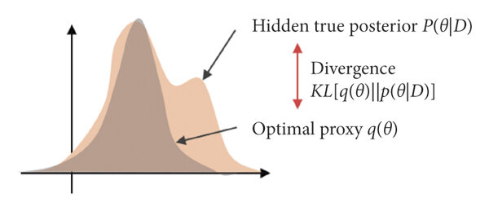

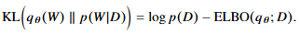
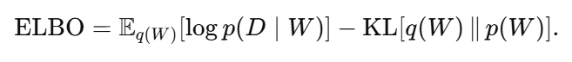
Variational Inference
Complex weight spaces
Approximate distribution from family of candidate distributions
KL divergence
Bayesian Backpropagation with gradient descent
https://www.researchgate.net/figure/The-variational-inference-for-analyzing-the-optimal-posterior-distribution-pthD-by_fig9_346994086

Slide 6
Results
Variational DropConnect
Two Moons Dataset
Concept Drift:
Logistic Regression
Evolving Classifier on MNIST
One-Step-Ahead Prediction for Flag Waving
All figures on slides 8-14 come from:
Rimella L, Whiteley N. Hidden Markov Neural Networks. Entropy (Basel). 2025 Feb 5;27(2):168. doi: 10.3390/e27020168. PMID: 40003165; PMCID: PMC11854577.

Slide 7
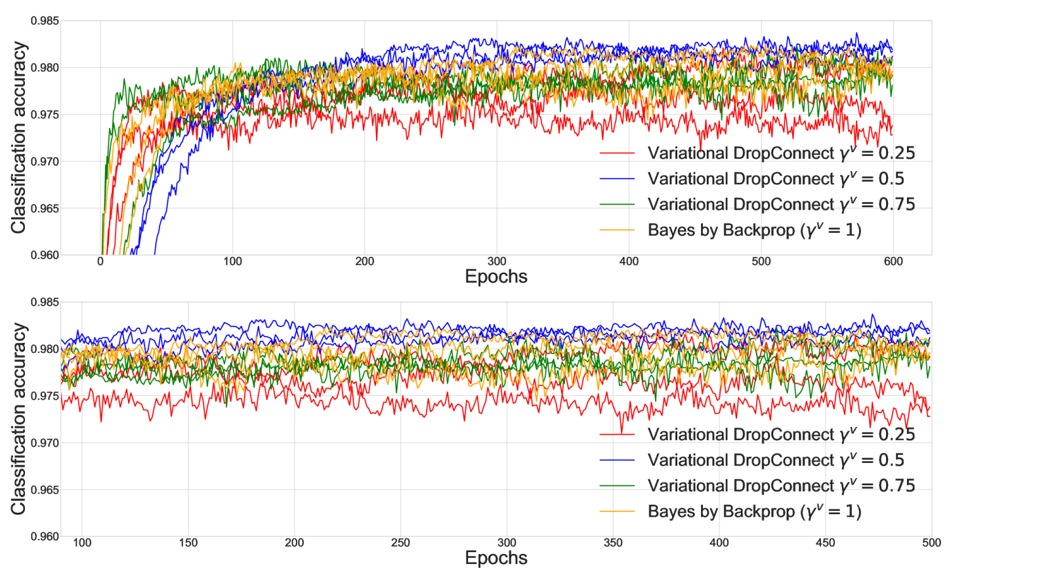
Results - Variational DropConnect

Slide 8
Results - Variational DropConnect

Slide 9
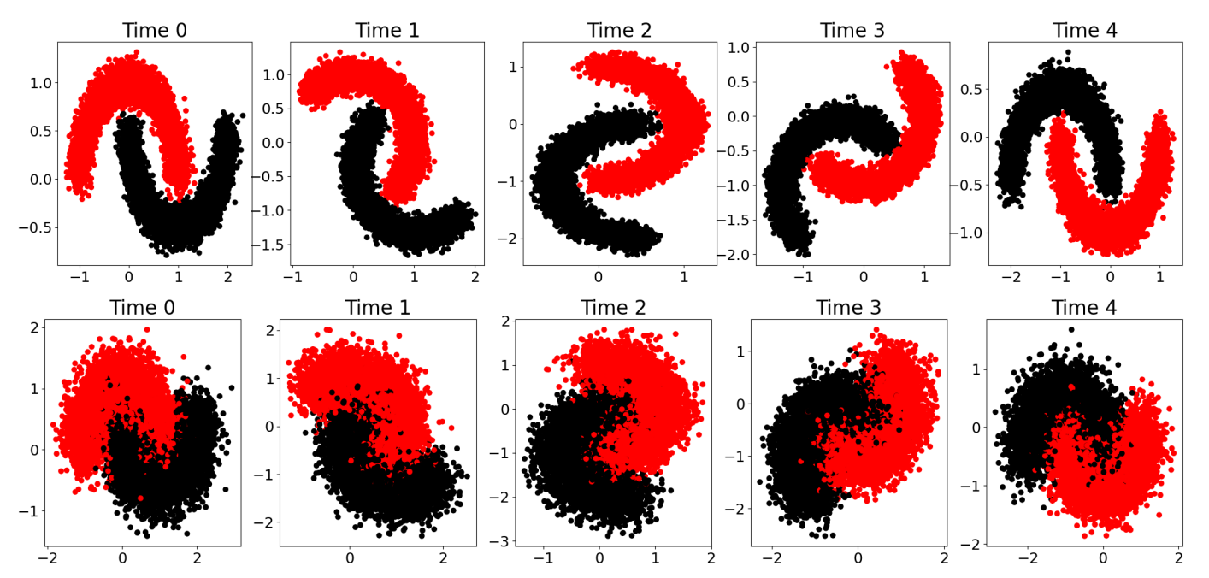
Results - Two Moons

Slide 10
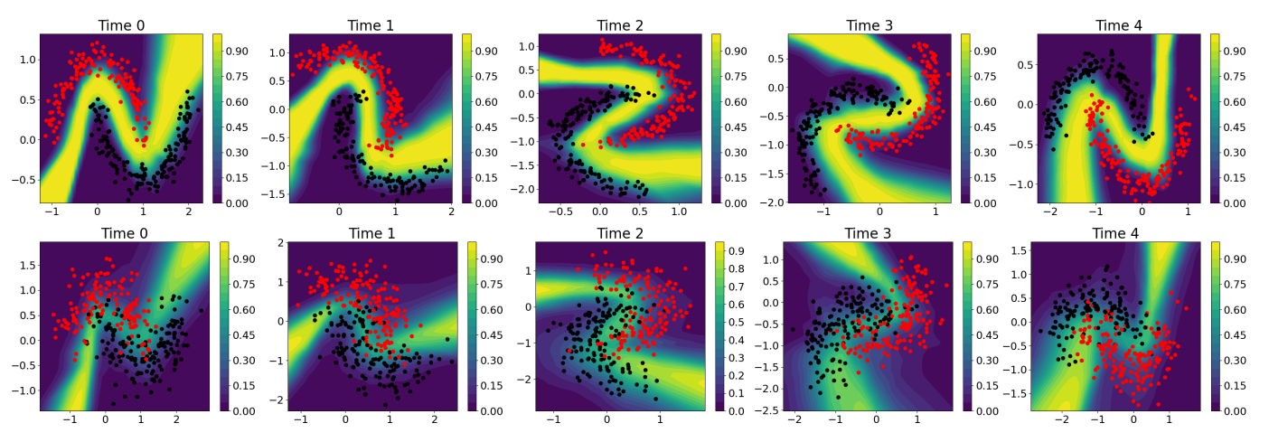
Results - Two Moons

Slide 11
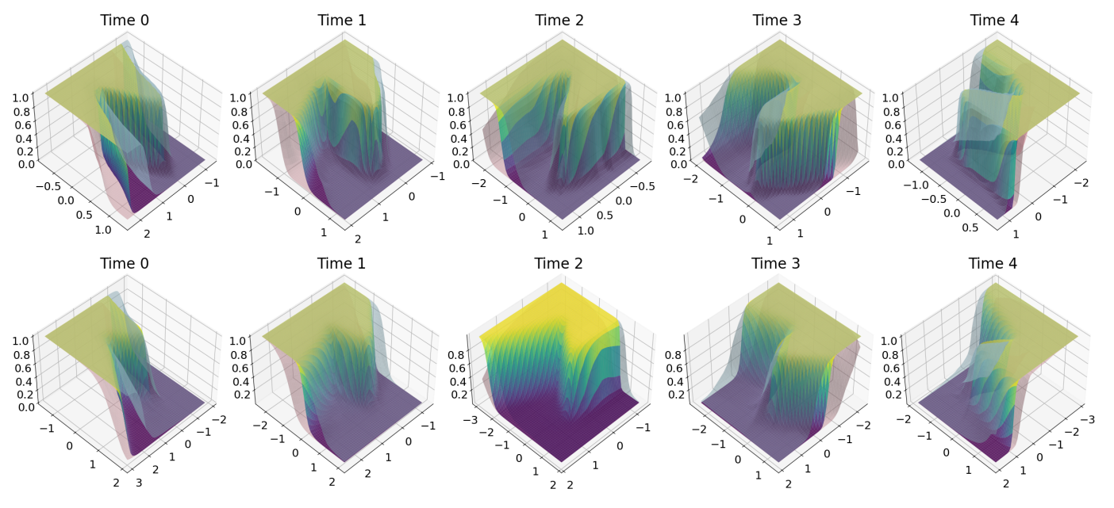
Results - Two Moons

Slide 12
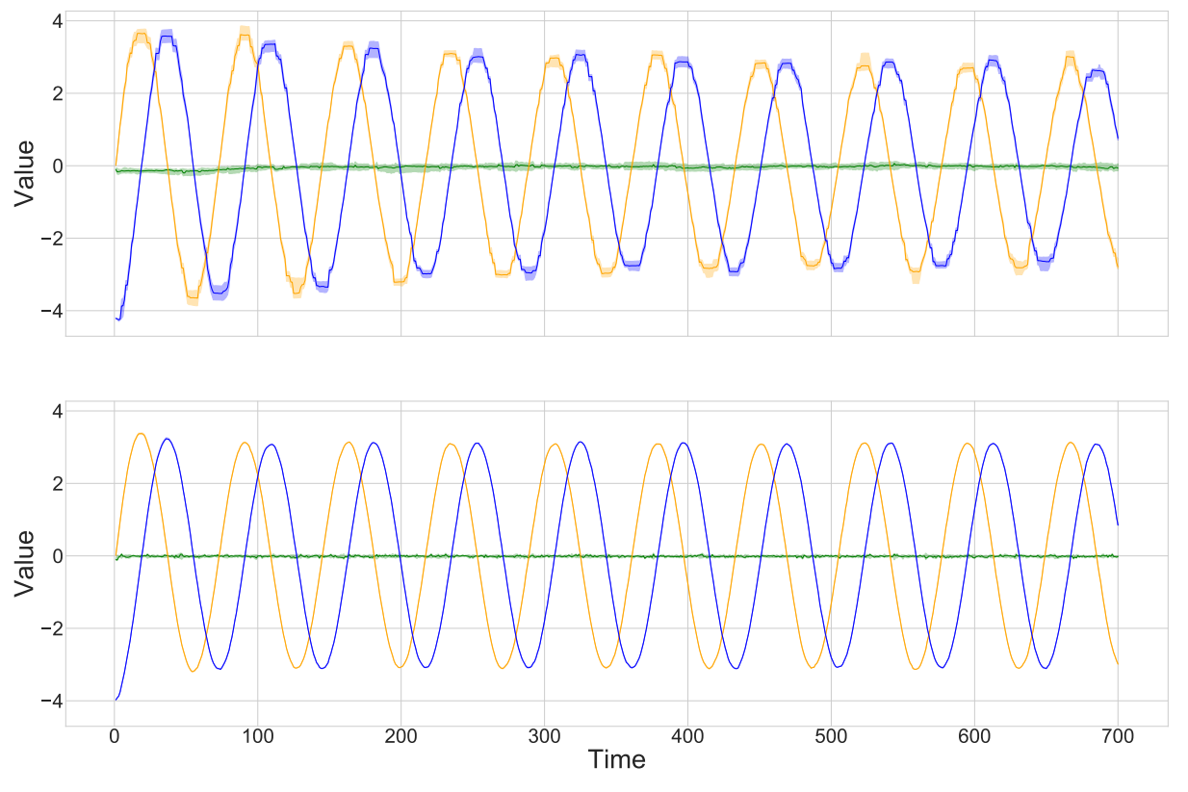
Results - Concept Drift: Logistic Regression

Slide 13
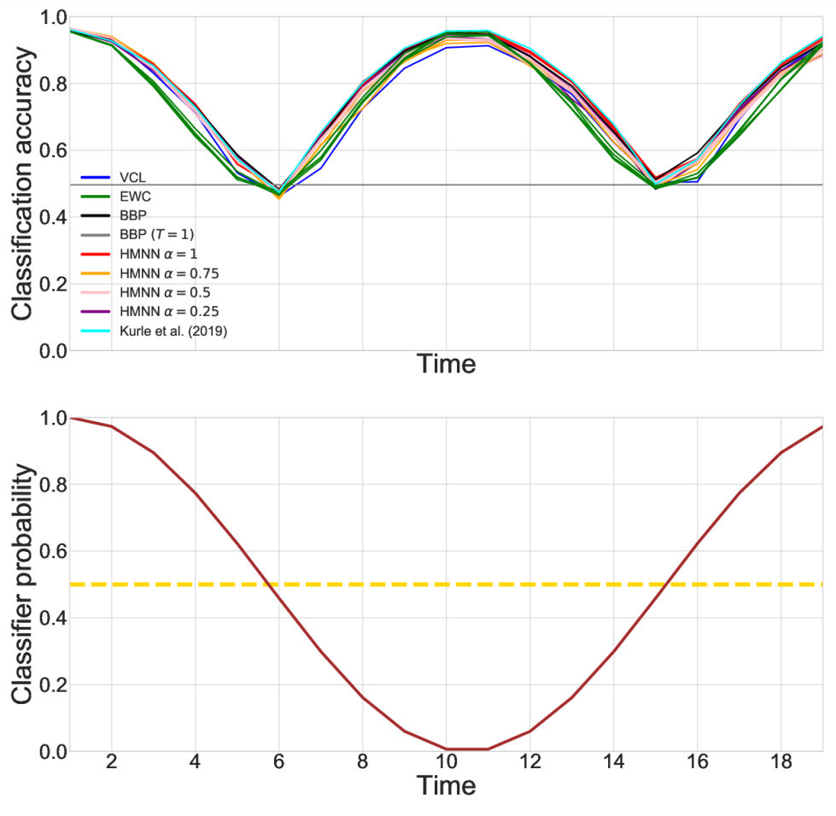
Results - Concept Drift: Evolving Classifier
Accuracy
Shifting Classifier

Slide 14
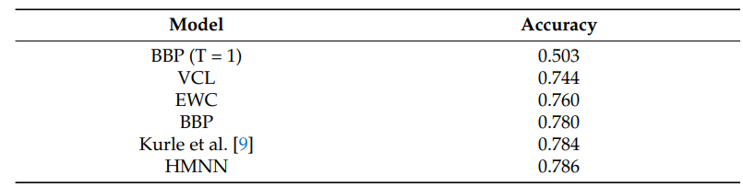
Results - Concept Drift: Evolving Classifier

Slide 15
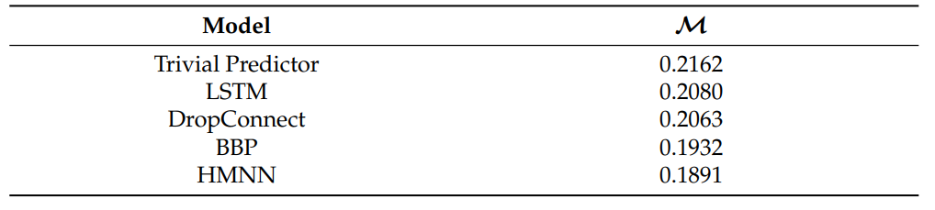
Results -One-Step-Ahead Prediction for Flag Waving

Slide 16
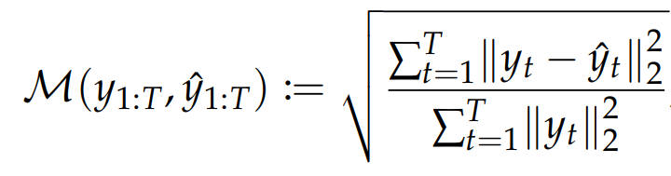
Results -One-Step-Ahead Prediction for Flag Waving

Slide 17
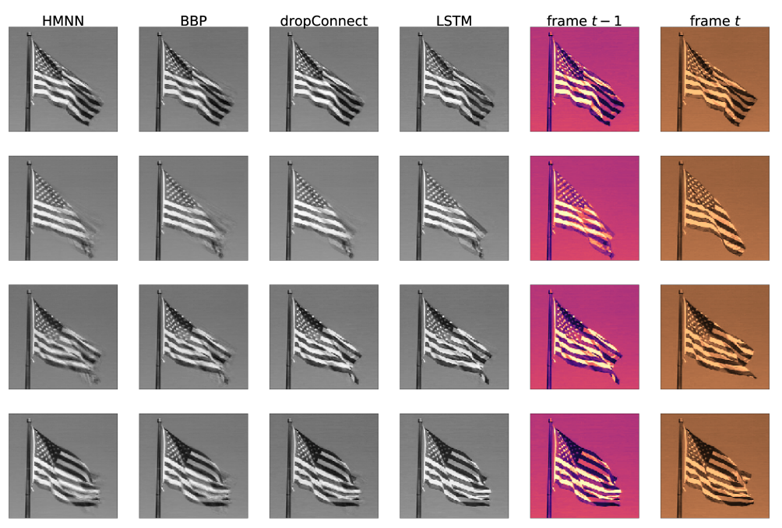
Results -One-Step-Ahead Prediction for Flag Waving

Slide 18
Discussion and Conclusion
Good results for chosen tests
Uncertainty rate
Smoothing algorithms
Relatively Simple Architecture
Test on more complex tasks

Slide 19
Questions?
or/and applause

